Slide 1
Detection of Malaria using Convolutional Neural Network

Slide 2
Aim
The aim of this paper is to detect malaria in individuals, who have the symptoms of malaria using a machine learning algorithm named Convolutional Neural Network.

Slide 3
Objective
To detect the infected cell using Multi Layer Perceptron.
The main objective is to detect the infected cells based on the symptoms analysis.

Slide 4
Abstract
Malaria is the deadliest disease caused by plasmodium falciparum virus, traveled through all around the world by pathogen of mosquitoes, starting from fever to coma and death.
Traditional way of diagnosing malaria is by examining blood under microscope by qualified technicians.
Decades of effort have been devoted to establishing an automated microscopic diagnosis of malaria.
But there are challenges in achieving expert-level performance in real-world clinical settings because publicly available annotated data for benchmark and validation are required.
This paper proposes machine learning model based on CNN which automatically classifies and predicts infected cells.

Slide 5
Introduction
Malaria is a mosquito borne infectious disease caused by single celled organisms.
The origin of malaria is from the continent Africa.
It is widely spread over tropical and subtropical regions through the vector called female Anopheles Mosquito.
When a female anopheles mosquito bit a malaria infected person and then bites a healthy person, the malarial parasites enter into the body of the healthy person and further develops to multiply the infectious cells and leads to an infectious stage of malaria called the Sporozoites.
These cells when spread over the liver results in rupture of RBCs and releases a toxic substance called Haemozin which causes fever and chillness in the body.

Slide 6
Literature Survey
S.No | Title | Author & Year | Method | Merit | Demerit
1 | Detection of malaria parasites using digital image processing | A. Bashir, Z. A. Mustafa, I. Abdelhameid and R. Ibrahem, 2017 | Uses ANN classifier for detection of malarial parasites | Accurate, rapid and affordable | Not fully automatic diagnosis method
2 | Automated image processing method for the diagnosis and classification of malaria on thin blood smears | Nicholas E. Ross., Charles J. Pitchard., David M. Rubin and Adriano G. Duse., 2020 | An image processing algorithm to automate the diagnosis of malaria on thin blood smears is developed | Highly sensitive at diagnosing a complete sample | False-negative detection occurred in several challenging situations
3 | Malaria Detection using Deep Learning | G. Shekar, S. Revathy and E. K. Goud, 2020 | Highly robust machine learning model based on CNN | High accuracy rate and low time duration | Very cost-effective process

Slide 7
Literature Survey…
S.No | Title | Author & Year | Method | Merit | Demerit
4 | Segmentation of malarial parasites in peripheral blood smear images | Vishnu V. Makkapati and Raghuveer M. Rao., 2009 | Segmenting HSV color space RBCs and parasites by detecting dominant hue range and by calculating optimal saturation threshold | Less computation-intensive than existing approaches are proposed to remove artifacts | Pre-processing of input images is not much efficient
5 | Deep learning for smartphone-based malaria parasite detection in thick blood smears | Yang F, Poostchi M, Yu H, et al., 2019 | A customized CNN classifies each candidate as either parasite or background. | Alternative to manual parasite counting for malaria diagnosis, in areas lacking experienced parasitologists | Smart phone runtime is less.
6 | Automatic identification of malaria-infected RBC with digital holographic microscopy using correlation algorithms | A. Anand, V. K. Chhaniwal, N. R. Patel and B. Javidi, 2012 | Digital holographic interferometric microscopy (DHIM) with numerical focusing for automatic identification of malaria-infected RBCs | For healthcare personnel working in developing countries, which lack trained professionals, high-quality equipment | Slow recognition process

Slide 8
Literature Survey…
S.No | Title | Author & Year | Method | Merit | Demerit
7 | Evaluations of deep convolutional neural networks for automatic identification of malaria infected cells | Dong Y, Jiang Z, Shen H, et al., 2017 | Evaluated three types of well-known convolutional neural networks, including LeNet, AlexNet and GoogLeNet | Requires minimal inputs from human experts for automated diagnosis. | Dataset contains less pathologist-curated cell images
8 | Classification accuracies of malaria infected cells using deep convolutional neural networks based on decompressed images | Dong Y, Jiang Z, Shen H, PanWD., 2017 | Decompressed images were fed into LeNet-5 for training and testing | Compression ratio much higher than the other lossy image compression methods | Knowledge gathering for using decompressed image as input was required
9 | Very deep convolutional neural network based image classification using small training sample size | Shuying Liu and Weihong Deng., 2015 | A modified VGG-16 Deep Convolutional Neural Network is used to fit CIFAR-10 | Can be used to fit small datasets with simple and proper modifications | No theoretical or practical demonstration on large datasets

Slide 9
Literature Survey…
S.No | Title | Author & Year | Method | Merit | Demerit
10 | Classification of time-series images using deep convolutional neural network | Nima Hatami., Yann Gavet and Johan Debayale., 2017 | Boost the recognition rate of Time-Series Classification (TSC). | Recurrence Plots (RP) used to transform time-series into 2D texture images and deep CNN classifier | Uses only less feature representation layers and applied for only small datasets

Slide 10
Existing System
The traditional way of diagnosing malaria is by schematic examining blood smears of human beings for parasite-infected red blood cells under the microscope.
It was done qualified technicians in laboratories.

Slide 11
Disadvantages
Well knowledgeable person needed for the examination.
Inefficient.
Low accuracy.
High time consumption.

Slide 12
Proposed System
This paper proposes a new and highly robust machine learning model based on a Convolutional Neural Network (CNN) which automatically classifies and predicts infected cells in thin blood smears on standard microscope slides.
The proposed work starts with decision taking whether the cell is infected or not.
Then start training the machine by giving all the attributes of the images.
Once all the images are acquired, the training process gets started followed by validation, and testing.
After receiving desired accuracy, the developed model is ready for use with real malaria samples.

Slide 13
Advantages of Proposed System
High accuracy.
Low time consumption.
No need for any qualified technicians.

Slide 14
Block Diagram
Training Dataset
Pre-processing
Feature Extraction
Model Training using CNN
Evaluation
Malaria Detection
Test Data
Pre-processing
Feature Extraction

Slide 15
Explanation
Collect the pre-processed images and merge them under one file for easy transportation.
Split the images according to train and test using sklearn.
Use OpenCV at the images and understand the parameters of it, followed by contour detection.
Process the image using thread pool executor for not to face time straining.
Create the Basic CNN model from scratch and fit the model.
Now insert the images into the model and run the model by using tensor flow and Keras packages.
Use Epoch = (number of iterations * batch size) / total number of images in training.
Check the accuracy if it is not sufficient run the CNN model again.
If the accuracy is sufficient, then stop here and get the accuracy rate.

Slide 16
Algorithm
Convolutional Neural Network (CNN)
A convolutional neural network (CNN) is a type of artificial neural network used in image recognition and processing that is specifically designed to process pixel data.
A convolutional neural network, or ConvNet, is just a neural network that uses convolution.
In the case of CNN, convolution is applied to the input data to filter the information and produce a feature map.
The goal of CNN is to reduce the images so that it would be easier to process without losing features that are valuable for accurate prediction.

Slide 17
Modules
Data Collection
Pre-processing
Feature Extraction
Model Training using CNN
Evaluation

Slide 18
Module Explanation
Data Collection
Collect the images of thin microscopic blood smear samples which contains malaria parasite infection, from hospitals or medical laboratories.
Pre-processing
Collected images are pre-processed and merged under one file for easy transportation.
Split the images as train and test sets.

Slide 19
Module Explanation…
Feature Extraction
19 diﬀerent feature vectors were extracted based on variances, correlation coeﬃcients, and histograms (speciﬁc variables from histograms, full histograms, and principal components from the histograms).
The feature vectors were visually analyzed to see their capability of classifying images into two classes: good and bad coloration quality.
Model Training using CNN
The training dataset is passed onto different layers of the CNN model for model training for several number of epochs.
Convolution Layer: The input image acts as the feature indicator and performing the convolution operation on the input image using filter results in a feature map which is also a matrix.

Slide 20
Module Explanation…
Pooling Layer: Pooling operation summarizes the features extracted by the convolution operation.
Dense Layer: A dense layer is a fully connected neural network layer which resembles a multi-layer perceptron.
The output of the last pooling layer is flattened and fed into the first dense layer. All the neurons of the first dense layer are fully connected to the last dense layer which has only 1 neuron as this CNN model is basically a binary classifier.
The output of the final dense layer points to the predicted class.
If the predicted value is 0, the model classifies the input image as parasitized and if the predicted value is 1, the model classifies the input image as uninfected.

Slide 21
Module Explanation…
Evaluation
Trained model is evaluated for each epoch and accuracy is checked.
If it is not sufficient then continue the model training.
If the accuracy is sufficient, then the model is ready for use in malaria detection for real samples.

Slide 22
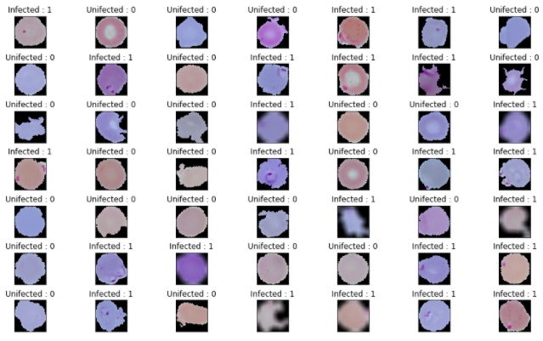
Input

Slide 23
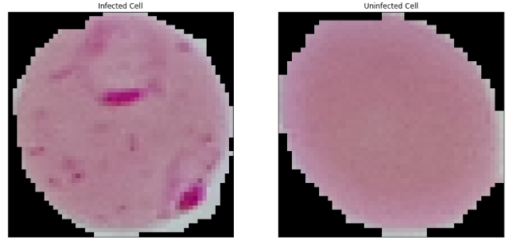
Sample of blood cell images of both healthy and infected

Slide 24
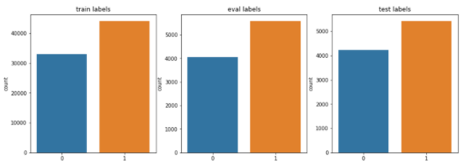
Dataset Split

Slide 25
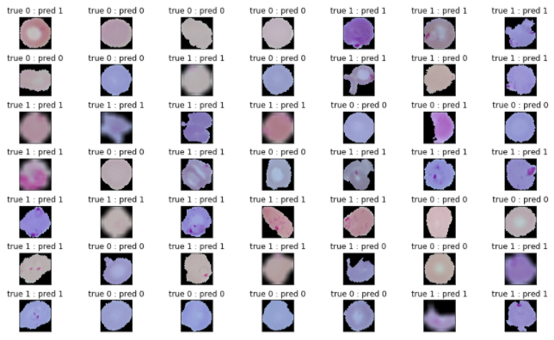
Output

Slide 26
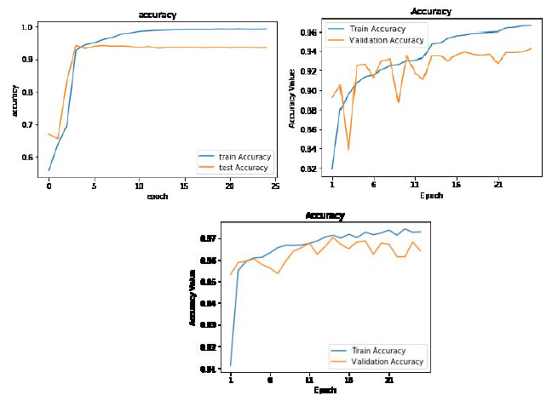
Performance Evaluation

Slide 27
Conclusion
The main aim of this proposed work is to develop an efficient deep learning model to predict Malaria disease.
Malaria detected from the traditional method, that is bringing the samples and analyzing cell growth requires more time.
In the proposed system, a deep learning model based on CNN algorithm has been constructed to predict Malaria with a high accuracy rate and low time duration.
The proposed CNN model is constructed and identified as the highest accuracy model.

Slide 28
Future Enhancement
In future work plan is to focus on network architecture of the models used in the research to find the driving performance factors.
Then, finding the ways to improve the performance by manipulating the network architecture and hyper tuning the features to achieve better performing model.

Slide 29
Source Code
from __future__ import absolute_import, division, print_function
import numpy as np # linear algebra
import pandas as pd # data processing, CSV file I/O (e.g. pd.read_csv)
import tensorflow as tf
import cv2
import matplotlib.pyplot as plt
import seaborn as sns
from PIL import Image
import os
print(os.listdir("../input/cell_images/cell_images"))
infected = os.listdir('../input/cell_images/cell_images/Parasitized/')
uninfected = os.listdir('../input/cell_images/cell_images/Uninfected/')
data = []
labels = []
for i in infected:
try:
image = cv2.imread("../input/cell_images/cell_images/Parasitized/"+i)
image_array = Image.fromarray(image , 'RGB')
resize_img = image_array.resize((50 , 50))
rotated45 = resize_img.rotate(45)
rotated75 = resize_img.rotate(75)
blur = cv2.blur(np.array(resize_img) ,(10,10))
data.append(np.array(resize_img))
data.append(np.array(rotated45))
data.append(np.array(rotated75))
data.append(np.array(blur))
labels.append(1)
labels.append(1)
labels.append(1)
labels.append(1)
except AttributeError:
print('')

Slide 30
Source Code…
for u in uninfected:
try:
image = cv2.imread("../input/cell_images/cell_images/Uninfected/"+u)
image_array = Image.fromarray(image , 'RGB')
resize_img = image_array.resize((50 , 50))
rotated45 = resize_img.rotate(45)
rotated75 = resize_img.rotate(75)
data.append(np.array(resize_img))
data.append(np.array(rotated45))
data.append(np.array(rotated75))
labels.append(0)
labels.append(0)
labels.append(0)
except AttributeError:
print(‘’)
print('')
cells = np.array(data)
labels = np.array(labels)
np.save('Cells' , cells)
np.save('Labels' , labels)
print('Cells : {} | labels : {}'.format(cells.shape , labels.shape))
plt.figure(1 , figsize = (15 , 9))
n = 0
for i in range(49):
n += 1
r = np.random.randint(0 , cells.shape[0] , 1)
plt.subplot(7 , 7 , n)
plt.subplots_adjust(hspace = 0.5 , wspace = 0.5)
plt.imshow(cells[r[0]])
plt.title('{} : {}'.format('Infected' if labels[r[0]] == 1 else 'Unifected' ,
labels[r[0]]) )
plt.xticks([]) , plt.yticks([])
plt.show()
plt.figure(1, figsize = (15 , 7))
plt.subplot(1 , 2 , 1)
plt.imshow(cells[0])
plt.title('Infected Cell')
plt.xticks([]) , plt.yticks([])
plt.subplot(1 , 2 , 2)
plt.imshow(cells[60000])

Slide 31
Source Code…
plt.title('Uninfected Cell')
plt.xticks([]) , plt.yticks([])
plt.show()
n = np.arange(cells.shape[0])
np.random.shuffle(n)
cells = cells[n]
labels = labels[n]
cells = cells.astype(np.float32)
labels = labels.astype(np.int32)
cells = cells/255
from sklearn.model_selection import train_test_split
train_x , x , train_y , y = train_test_split(cells , labels ,
test_size = 0.2 ,
random_state = 111)
eval_x , test_x , eval_y , test_y = train_test_split(x , y ,
test_size = 0.5 ,
random_state = 111)
plt.figure(1 , figsize = (15 ,5))
n = 0
for z , j in zip([train_y , eval_y , test_y] , ['train labels','eval labels','test labels']):
n += 1
plt.subplot(1 , 3 , n)
sns.countplot(x = z )
plt.title(j)
plt.show()
print('train data shape {} ,eval data shape {} , test data shape {}'.format(train_x.shape, eval_x.shape, test_x.shape))
tf.reset_default_graph()
def cnn_model_fn(features , labels , mode):
input_layers = tf.reshape(features['x'] , [-1 , 50 , 50 ,3])
conv1 = tf.layers.conv2d(
inputs = input_layers ,
filters = 50 ,
kernel_size = [7 , 7],
padding = 'same',
activation = tf.nn.relu
)
conv2 = tf.layers.conv2d(

Slide 32
Source Code…
inputs = conv1,
filters = 90,
kernel_size = [3 , 3],
padding = 'valid',
activation = tf.nn.relu
)
conv3 = tf.layers.conv2d(
inputs = conv2 ,
filters = 10,
kernel_size = [5 , 5],
padding = 'same',
activation = tf.nn.relu
)
pool1 = tf.layers.max_pooling2d(inputs = conv3 , pool_size = [2 , 2], strides = 2 )
conv4 = tf.layers.conv2d(
inputs = pool1 ,
filters = 5,
kernel_size = [3 , 3],
padding = 'same',
activation = tf.nn.relu
)
pool2 = tf.layers.max_pooling2d(inputs = conv4 , pool_size = [2 , 2] , strides = 2 , padding = 'same’)
pool2_flatten = tf.layers.flatten(pool2)
fc1 = tf.layers.dense(
inputs = pool2_flatten,
units = 2000,
activation = tf.nn.relu
)
fc2 = tf.layers.dense(
inputs = fc1,
units = 1000,
activation = tf.nn.relu
)
fc3 = tf.layers.dense(
inputs = fc2 ,
units = 500 ,
activation = tf.nn.relu
)
logits = tf.layers.dense(
inputs = fc3 ,
units = 2
)

Slide 33
Source Code…
predictions = {
'classes': tf.argmax(input = logits , axis = 1),
'probabilities': tf.nn.softmax(logits , name = 'softmax_tensor')
}
if mode == tf.estimator.ModeKeys.PREDICT:
return tf.estimator.EstimatorSpec(mode = mode, predictions = predictions)
loss = tf.losses.sparse_softmax_cross_entropy(labels = labels , logits = logits)
if mode == tf.estimator.ModeKeys.TRAIN:
optimizer = tf.train.GradientDescentOptimizer(learning_rate = 0.001)
train_op = optimizer.minimize(loss = loss, global_step = tf.train.get_global_step())
return tf.estimator.EstimatorSpec(mode = mode, loss = loss, train_op = train_op)
eval_metric_op = {'accuracy' : tf.metrics.accuracy(labels = labels, predictions = predictions['classes’])}
return tf.estimator.EstimatorSpec(mode = mode, loss = loss, eval_metric_ops = eval_metric_op)
malaria_detector = tf.estimator.Estimator(model_fn = cnn_model_fn, model_dir = '/tmp/modelchkpt')
tensors_to_log = {'probabilities':'softmax_tensor'}
logging_hook = tf.train.LoggingTensorHook(
tensors = tensors_to_log , every_n_iter = 50)
train_input_fn = tf.estimator.inputs.numpy_input_fn(
x = {'x': train_x},
y = train_y,
batch_size = 100 ,
num_epochs = None ,
shuffle = True)
malaria_detector.train(input_fn = train_input_fn , steps = 1 , hooks = [logging_hook])
malaria_detector.train(input_fn = train_input_fn , steps = 10000)
eval_input_fn = tf.estimator.inputs.numpy_input_fn(
x = {'x': eval_x},
y = eval_y ,
num_epochs = 1 ,
shuffle = False
)

Slide 34
Source Code…
eval_results = malaria_detector.evaluate(input_fn = eval_input_fn)
print(eval_results)
pred_input_fn = tf.estimator.inputs.numpy_input_fn(
x = {'x' : test_x},
y = test_y,
num_epochs = 1,
shuffle = False
)
y_pred = malaria_detector.predict(input_fn = pred_input_fn)
classes = [p['classes'] for p in y_pred]
from sklearn.metrics import confusion_matrix, classification_report, accuracy_score
print('{} \n{} \n{}'.format(confusion_matrix(test_y, classes), classification_report(test_y , classes) , accuracy_score(test_y , classes)))
plt.figure(1 , figsize = (15 , 9))
n = 0
for i in range(49):
n += 1
r = np.random.randint( 0 , test_x.shape[0] , 1)
plt.subplot(7 , 7 , n)
plt.subplots_adjust(hspace = 0.5 , wspace = 0.5)
plt.imshow(test_x[r[0]])
plt.title('true {} : pred {}'.format(test_y[r[0]] , classes[r[0]]) )
plt.xticks([]) , plt.yticks([])
plt.show()

Slide 35
References
A. Bashir, Z. A. Mustafa, I. Abdelhameid and R. Ibrahem, "Detection of malaria parasites using digital image processing," IEEE 2017, International Conference on Communication, Control, Computing and Electronics Engineering (ICCCCEE), 2017, pp. 1-5
Nicholas E. Ross., Charles J. Pitchard., David M. Rubin and Adriano G. Duse “Automated image processing method for the diagnosis and classification of malaria on thin blood smears” IEEE Vol.44. 2020.
G. Shekar, S. Revathy and E. K. Goud, "Malaria Detection using Deep Learning," 2020 4th International Conference on Trends in Electronics and Informatics (ICOEI)(48184), IEEE 2020, pp. 746-750
Vishnu V. Makkapati and Raghuveer M. Rao., “Segmentation of malarial parasites in peripheral blood smear images” IEEE International Conference on Acoustics, Speech and Signal Processing. 2009.
Yang F, Poostchi M, Yu H, et al., “Deep learning for smartphone-based malaria parasite detection in thick blood smears”. IEEE J Biomed Health Inform. 2019;(September):1-1.
A. Anand, V. K. Chhaniwal, N. R. Patel and B. Javidi, "Automatic identification of malaria-infected RBC with digital holographic microscopy using correlation algorithms", IEEE Photonics J., vol. 4, no. 5, pp. 1456-1464, 2012.

Slide 36
References…
Dong Y, Jiang Z, Shen H, et al., “Evaluations of deep convolutional neural networks for automatic identification of malaria infected cells”. In: Proceedings of the 2017 IEEE EMBS International Conference on Biomedical & Health Informatics. Piscataway, NJ: Institute of Electrical and Electronics Engineers; 2017:101-104.
Dong Y, Jiang Z, Shen H, PanWD., “Classification accuracies of malaria infected cells using deep convolutional neural networks based on decompressed images”. In: Proceedings of the 2017 IEEE EMBS International Conference on Biomedical & Health Informatics. Piscataway, NJ: Institute of Electrical and Electronics Engineers; 2017:1-6.
Shuying Liu and Weihong Deng., “Very deep convolutional neural network based image classification using small training sample size” IEEE 2015, 3rd IAPR Asian Conference on Pattern Recognition (ACPR).
Nima Hatami., Yann Gavet and Johan Debayale., “Classification of time-series images using deep convolutional neural network” Tenth International Conference on Machine Vision (ICMV 2017) Vol.10696.

Slide 37
Thank You…

